Slide 1
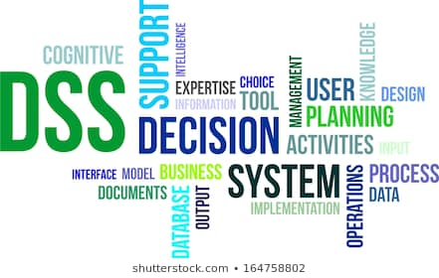
Decision Support Systems
Decision Support Systems Concepts, Methodologies, and Technologies:
An Overview
Lecture 7

Slide 2
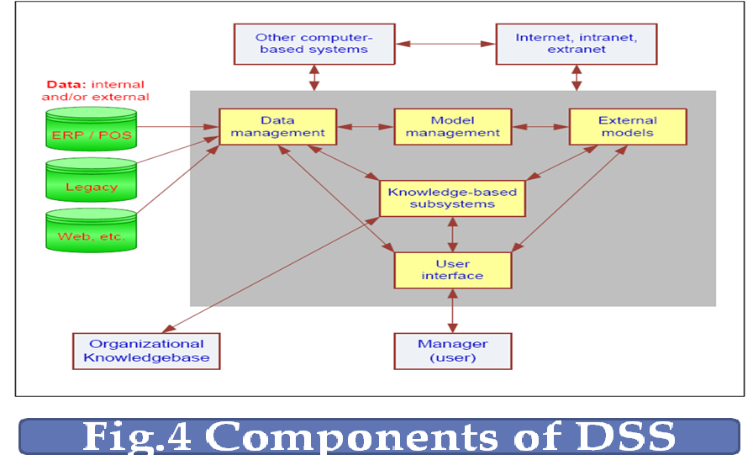
Components of DSS

Slide 3
Components of DSS
Data Management Subsystem
Includes the database that contains the data
Database management system (DBMS)
Can be connected to a data warehouse
Model Management Subsystem
Model base management system (MBMS)
User Interface Subsystem
Knowledgebase Management Subsystem
Organizational knowledge base

Slide 4
DSS Components and Web Impacts
Impacts of Web to DSS
Data management via Web servers
Easy access to variety of models, tools
Consistent user interface (browsers)
Deployment to PDAs, cell phones, etc. …
DSS impact on Web
Intelligent e-Business/e-Commerce
Better management of Web resources and security,

Slide 5
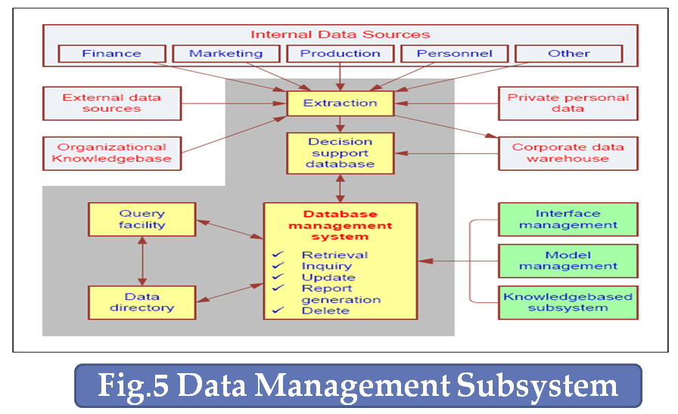
Data Management Subsystem

Slide 6
Data Management Subsystem
1- DSS Database
Several databases can be used in one DSS application, depending on the data sources.
The data in the DSS database are extracted from internal and external data sources, as well as from personal data belonging to one or more users.
Internal data come mainly from the organization’s Transaction Processing System.
Internal data can be made available through web browsers over an intranet, an internal web based system.
External data include industry data, market research data, census data, regional employment data, government regulation, etc.,
Private data can include guidelines used by specific decision makers and assessments of specific data or situation.

Slide 7
Data Management Subsystem
1- DSS Database
Similarities between Internal, external and private data
All these types can be in any form—structured record/field files, text files, or multimedia of various types.
All can be objective or subjective.
All can be, managed by a DBMS.
All can be used to support a wide variety of decisions.
All can be accessed via a Web interface.

Slide 8
Data Management Subsystem
1- DSS Database
Extraction
To create a DSS database, it is often necessary to capture data from several sources. This operation is called extraction.
It basically consists of importing of files, summarization, standardization filtration, and condensation of data. Extraction also occurs when the user produces reports from data in the database.
To extract data, an exact query must be made to several related data tables that may span several independent databases. The pieces to be extracted must be ―reconnected‖ so that useful DSS database results.

Slide 9
Data Management Subsystem
2- Database Management Systems
The Capabilities of DBMS in a DSS
Captures/extracts data for inclusion in a DSS database
Updates (adds, deletes, edits, changes) data records and files
Interrelates data from different sources
Retrieves data from the database for queries and reports
Provides comprehensive data security (protection from unauthorized access, recovery capabilities, etc.)
Performs complex data manipulation tasks based on queries
Tracks data use within the DSS
Manages data through a data dictionary

Slide 10
Data Management Subsystem
3- Data Directory
The data directory is a catalog of all the data in the database. It contains data definition, and its main function is to answer questions about :
Availability of data items.
Their sources.
Their exact meaning.
The directory is especially appropriate for supporting the intelligence phase.
The directory supports:
The addition of new entries.
Deletion of entries
Retrieval of information on specific objects

Slide 11
Data Management Subsystem
4- The Query Facility
The query facility performs the following tasks:
Access, manipulate, and query data.
It accepts requests for data from other DSS components.
Determines how the requests can be filled.
Formulates the detailed requests.
Return the results to the issuer of the request.

Slide 12
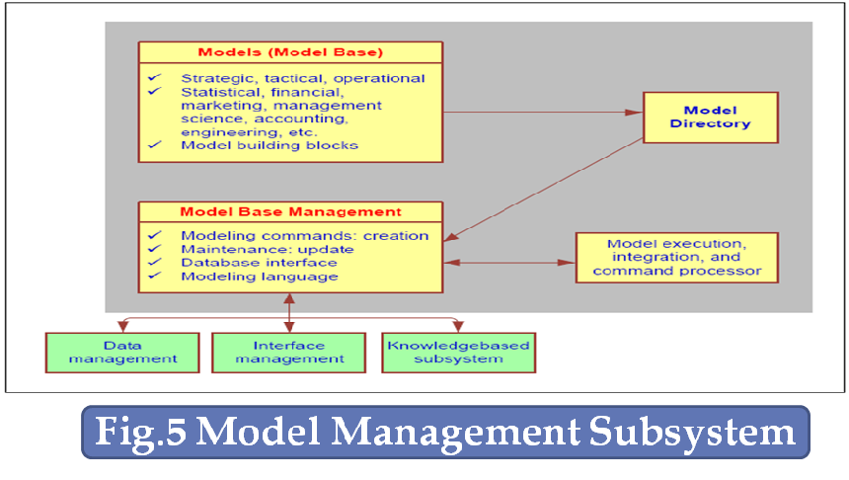
DSS Components Model Management Subsystem

Slide 13
DSS Components: Model Management Subsystem
Model Management Subsystem components:
Model base
MBMS
Modeling language
Model directory
Model execution, integration, and command processor

Slide 14
Model Management Subsystem
1- Model base
Strategic Models
Support top management decisions.
Planning for mergers and acquisitions.
Tactical Models
Support middle management
Assist in allocating and controlling the organization’s resources.
Operational Models
Support the day to day working activities of the organization.
Support first line managers’ decision making with a daily to monthly time horizon.
Analytical models
Used to perform some analysis on the data.
Include statistical models, management science models, data mining algorithms and financial models.

Slide 15
Model Management Subsystem
1- Model base
Model building blocks and routines
Preprogrammed software elements that can be used to build computerized models.
Examples: a present value computational routine and regression analysis.
Used in several ways:
1. They can be employed on their own for such applications as data analysis.
2. They can also be used as components of large models.
For example, a present value component can be part of a make or buy model.
Such building blocks are available in DSS commercial development software such as the functions in Excel.

Slide 16
Model Management Subsystem
2- Model Base Management Systems
Major functions of MBMS
Creates models easily and quickly.
Allows users to manipulate models.
Stores, retrieves, and manages a wide variety of different types of models in a logical and integrated manner.
Access and integrate the model building blocks.
Catalogs and display the directory of models for use by several individuals in the organization.
Tracks model data and application use.
Interrelates models with appropriate linkages with the database and integrates them within the DSS.
Manages and maintains the model base: Store, access, run, update, link, catalog, and query.

Slide 17
Model Management Subsystem
3- Modeling language
.NET Framework languages,
C++,
Java,
OLAP (work with models in data analysis),
SLAM (Simulation Language for Alternative Modeling),
SPSS (statistical packages)………,
4- MODEL DIRECTORY
The role of model directory is similar to that of database directory. It is a catalog of all the models and other software in the model base.
It contains model definitions, and its main function is to answer questions about the availability and capability of the models.

Slide 18
Model Management Subsystem
5- Model Management Activities
Model execution
Controls running of model
Model command processor
Receives model instructions from user interface
Routes instructions to MBMS or module execution or integration functions
Model integration
Combines several models’ operations

